Slide 1
Parent Meeting
Phonics Screening Check
Notes:
Approximately 10 minutes is needed for this session.
Notes are provided to help you lead the presentation.
Notes in italics are for your attention only.
Provide copies of ‘Reading at Home Booklet 2’ from Oxford Owl for each parent.

Slide 2
What is the Phonics Screening Check?
A word-reading test in June of Year 1 (WC Monday 8th June)
RWI phonics screen vs Phonics screening check
40 words: 20 real and 20 nonsense
Between 2 and 5 minutes
32 words pass mark

Slide 3
Sounds that could be tested

Slide 4

‘Special Friends’, ‘Fred Talk’

Slide 5




Nonsense words

Slide 6
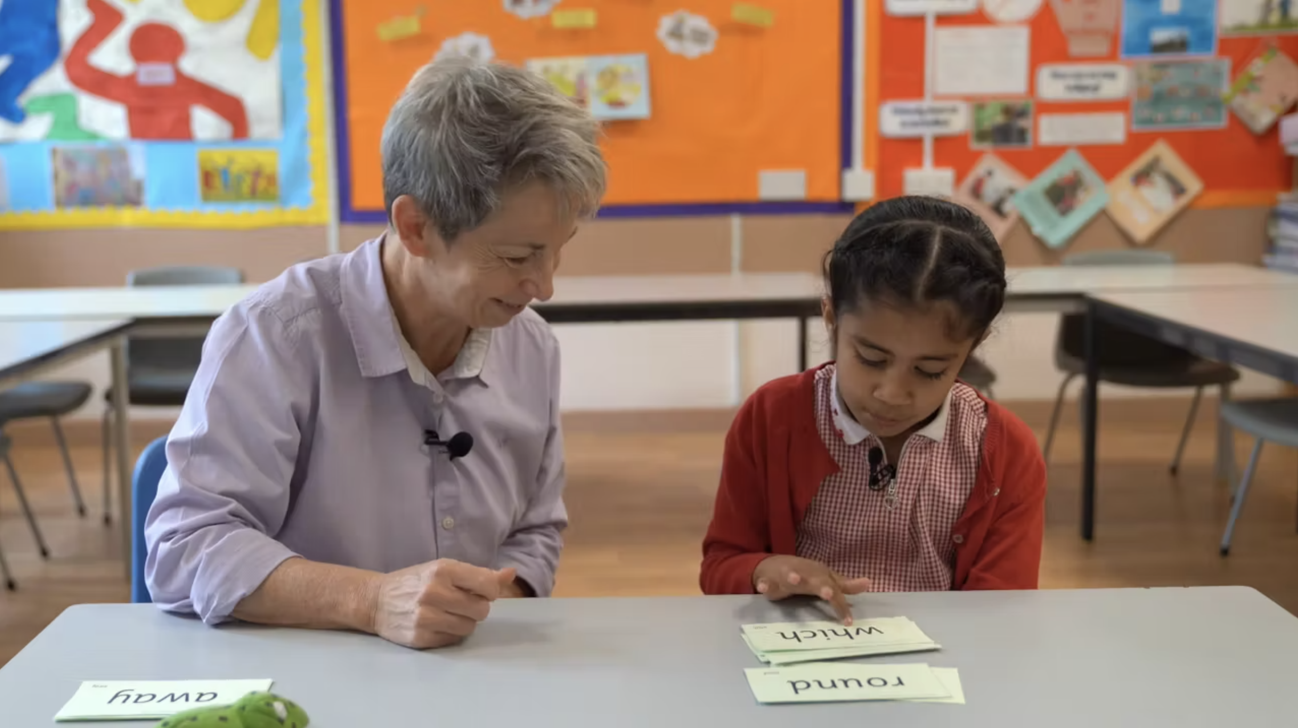
The phonics input in Y1
Daily phonics groups
Whole class speed sound
PSC preparation videos
QR codes, RWI books and flash cards
1:1 intervention
Pinny time
Extra resources sent home

Slide 7

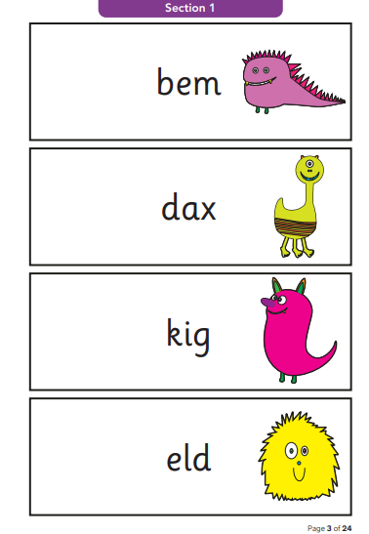
What does the screen look like?

Slide 8
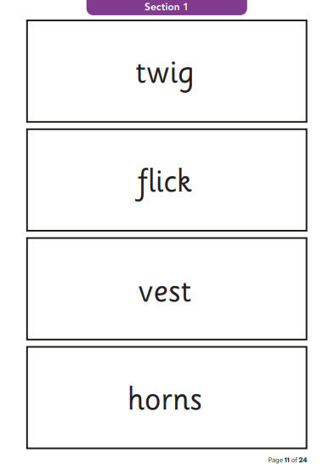
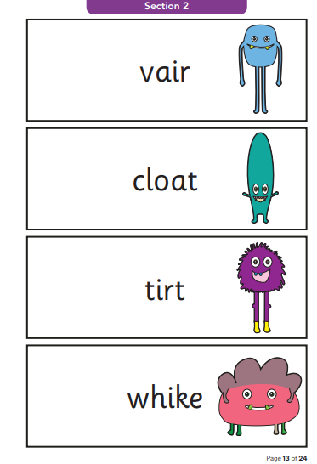
What does the screen look like?

Slide 9
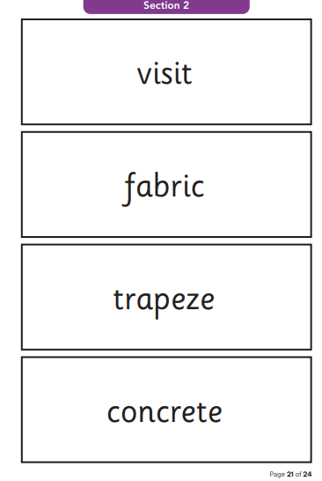
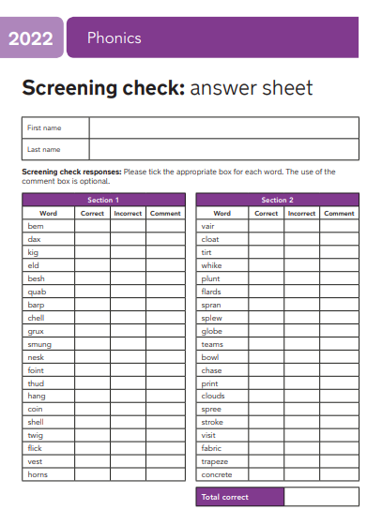
What does the screen look like?

Slide 10
Our duty
WC Monday 8th June 2026
Assess children of primary school educators first
Assess in a quiet room with no distractions or prompts
Not discuss results/information about the text until the end of June (with parents, staff or children)
Report the results to parents with school reports
Ensure access to accommodations
Monitoring visits

Slide 11
Accommodations
Rest breaks
Carefully selecting which adult administers the test
Visual changes to the test paper
S & L allowances
Accents

Slide 12
What can you do?
Help your child to use ‘Special Friends’, ‘Fred Talk’ to read words.
Practise reading sounds speedily.
Watch the Virtual Classroom films together.
Listen to your child read their Storybook every day.

Slide 13
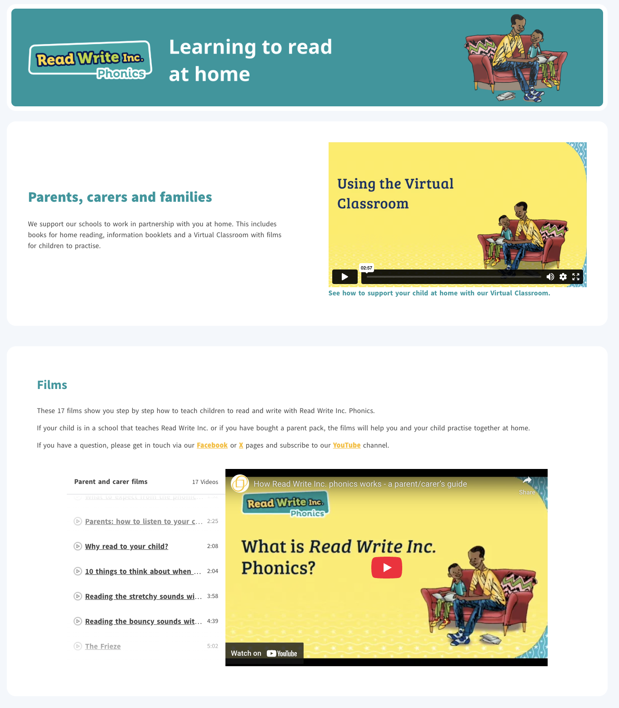
Free Video Tutorials (ruthmiskin.com)
Notes:
Watch these video tutorials on the Ruth Miskin website to find out more about the PSC:
Understanding Phonics
The Phonics Screening Check

Slide 14
Online resources available
Ruth Miskin Families Page:
https://www.ruthmiskin.com/parentsandcarers/
Ruth Miskin Facebook:
https://www.facebook.com/miskin.education
Free e-books for home reading:
http://www.oxfordowl.co.uk/Reading/

Slide 15

Any questions?

